Slide 1
Elastic-R, Toward an International Portal for On-Demand Scientific Computing, Collaboration and Resources Sharing
Karim Chine
karim.chine@cloudera.co.uk
Cloud Era Ltd
Cambridge - UK

Slide 2
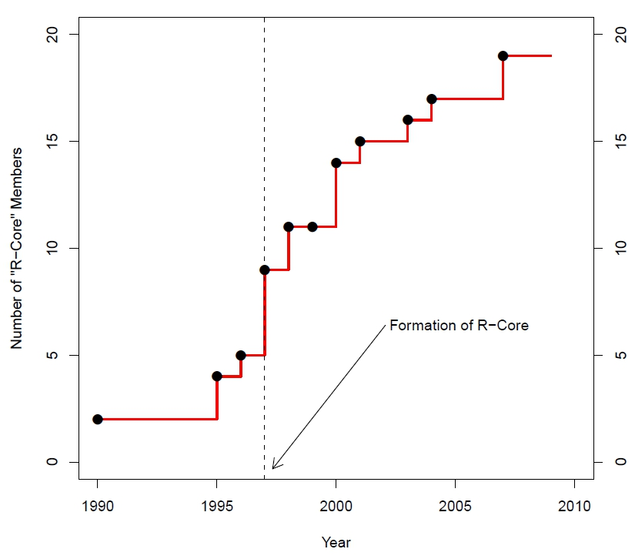
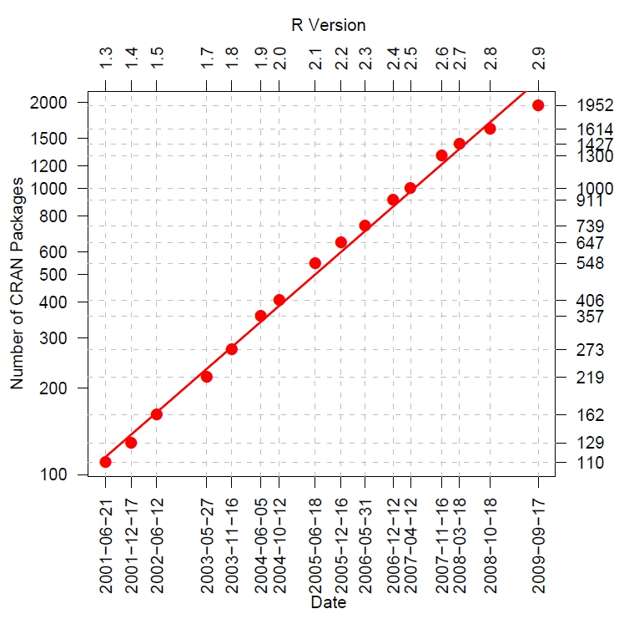
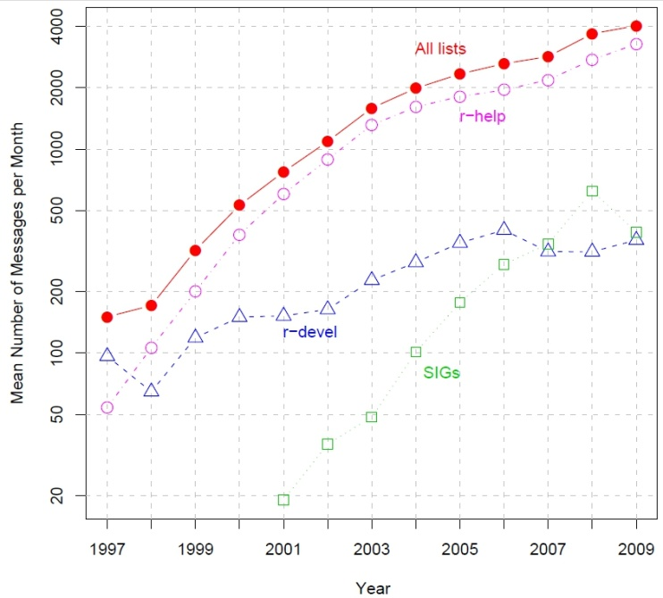
,lingua franca of data analysis
From: John Fox, Aspects of the Social Organization and Trajectory of the R Project, R Journal-Feb 2009

Slide 3
R + Elastic-R : « plug & play » computing environment
Computational Components
R packages : CRAN, Bioconductor, Wrapped C,C++,Fortran code
Scilab modules, Matlab Toolkits, etc.
Open source or commercial
Computational User Interfaces
Workbench within the browser
Built-in views / Plugins / Spreadsheets
Collaborative views
Open source or commercial
Computational Resources
Hardware & OS agnostic computing engine : R, Scilab,..
Clusters, grids, private or public clouds
free: academic grids or pay-per-use: EC2, Azure
Elastic-R
Computational Data Storage
Local, NFS, FTP, Amazon S3, Amazon EBS
free or commercial
Computational Scripts
R / Python / Groovy
On client side: interactivity..
On server side: data transfer ..
Generated Computational Web Services
Computational Application Programming Interfaces
Java / SOAP / REST, Stateless and stateful
Stateful or stateless, automatic mapping of R data objects and functions

Slide 4
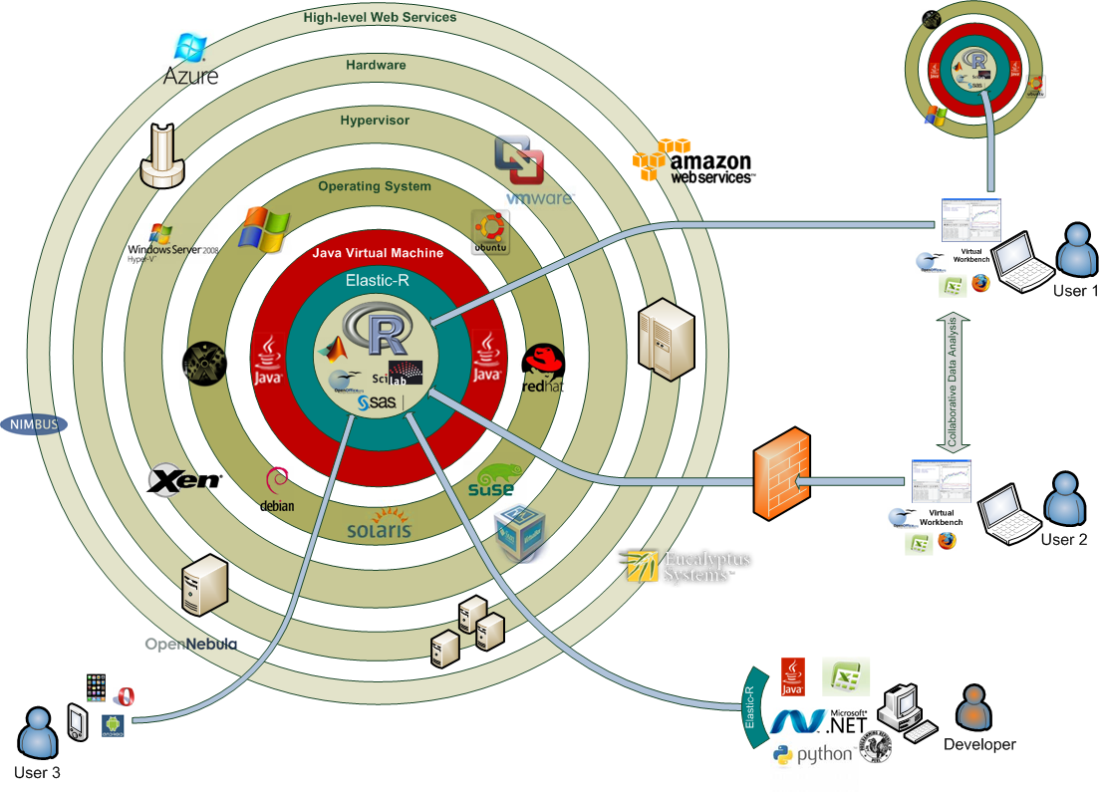
Elastic-R on IaaS-style clouds

Slide 5
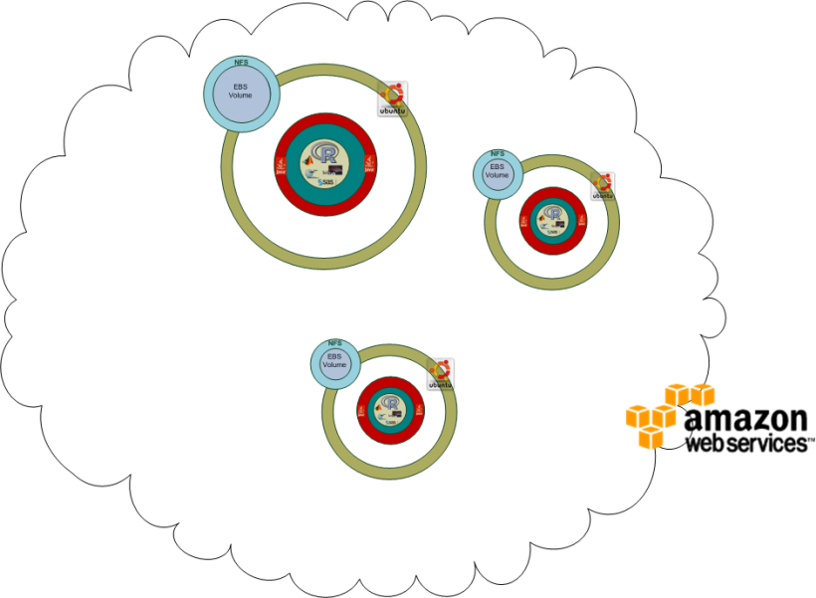
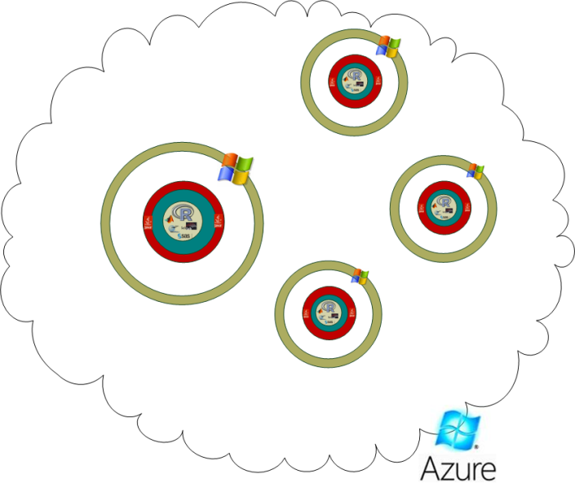
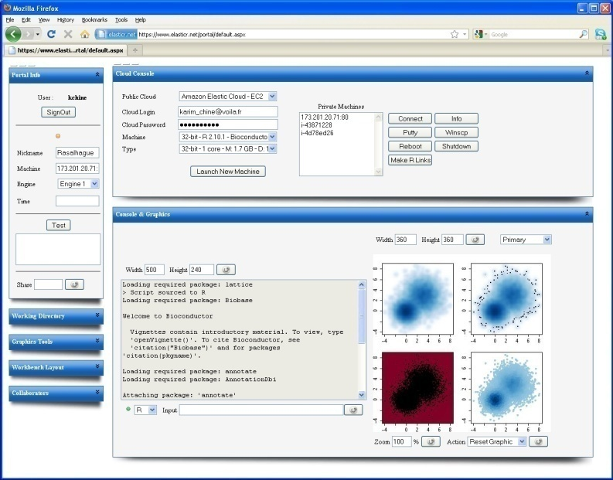
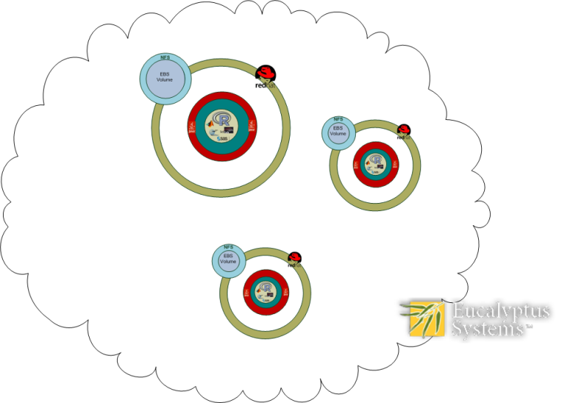
Elastic-R portal: single facade to public/private clouds
Public Clouds
Private Cloud

Slide 6
Elastic-R portal : collaborative Virtual Research Environment

Slide 7
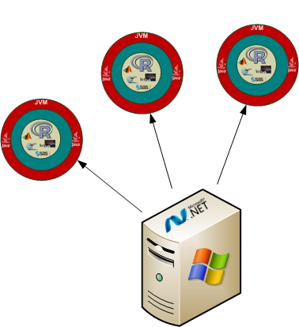
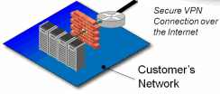
Decentralized collaboration : Elastic-R portal as an EC2 AMI
Amazon Virtual Private Cloud
Subnet 2
Subnet 1
Subnet 3

Slide 8
The IaaS-style cloud as a reproducible research platform
Elastic-R Amazon Machine Images
Elastic-R AMI 1
R 2.10
+
BioC 2.5
Elastic-R AMI 2
R 2.9
+
BioC 2.3
Elastic-R AMI 2
R 2.9
+
BioC 2.3
Elastic-R AMI 3
R 2.8
+
BioC 2.0
Elastic-R EBS 4
Data Set VVV
Amazon Elastic Block Stores
Elastic-R EBS 4
Data Set VVV
Elastic-R EBS 1
Data Set XXX
Elastic-R AMI 2
R 2.9
+
BioC 2.3
Elastic-R EBS 2
Data Set YYY
Elastic-R EBS 3
Data Set ZZZ
Elastic-R EBS 4
Data Set VVV

Slide 9
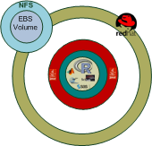
One Amazon account and many users : Elastic-R signed tokens
AWS
Credentials
+ Private Key
XXYYZZ
XXYYZZ
XXYYZZ
XXYYZZ
Generate token
Deliver token
Use token
Activate token
Launch machine instance
Register machine instance
Use R console
Call R Engine

Slide 10
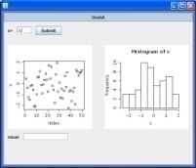
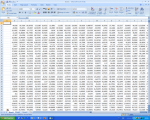
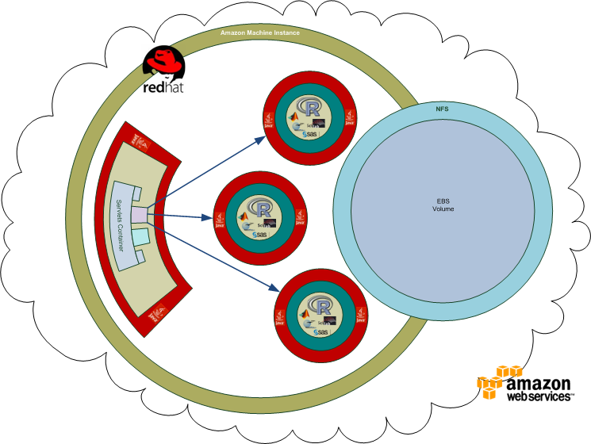
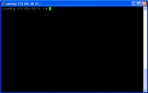
Elastic-R security
Restful WS over SSL
Restful WS over SSL
SOAP over SSL
Heartbeat
Restful WS over SSL
SSH
HTTPS

Slide 11
The Elastic-R AJAX Workbench I
Private virtual machines monitor
Simplified clouds management console
Virtual machines launcher
Session info
R Graphics
+ whiteboard
+ annotation
+ slides viewer
R console
+ scilab console
+ chat
+ ssh console

Slide 12
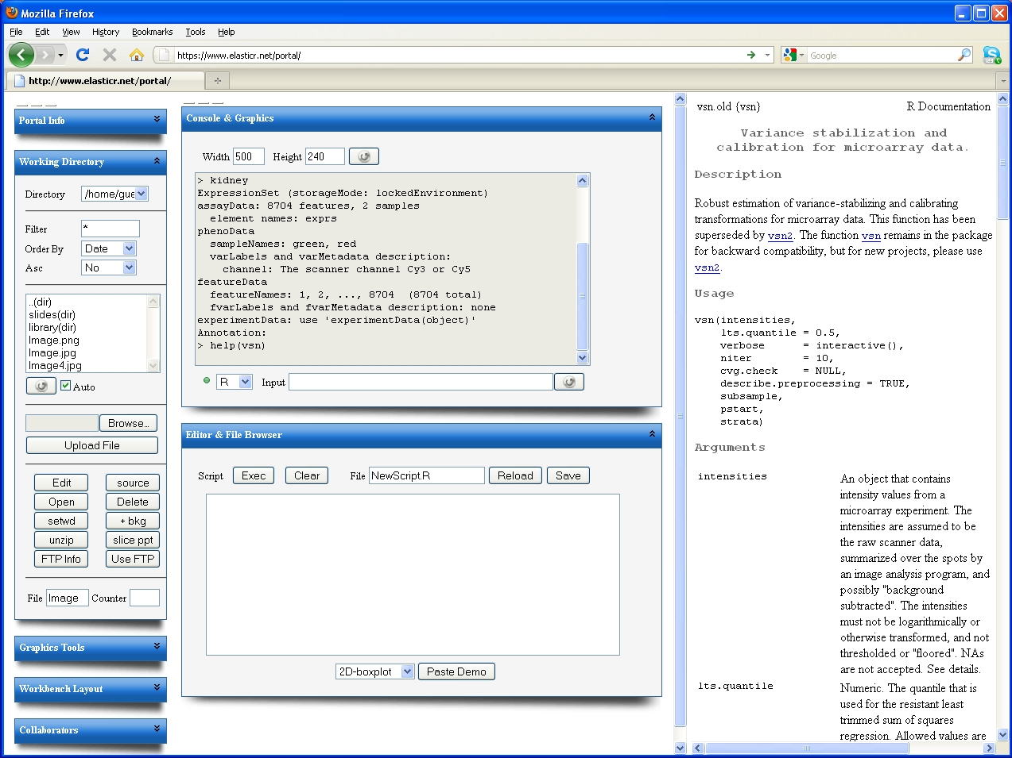
The Elastic-R AJAX Workbench II
Browsable contextual R help
Working directory browser
Files upload/download
to/from cloud machine instance
Collaborative console
Collaborative script editor

Slide 13
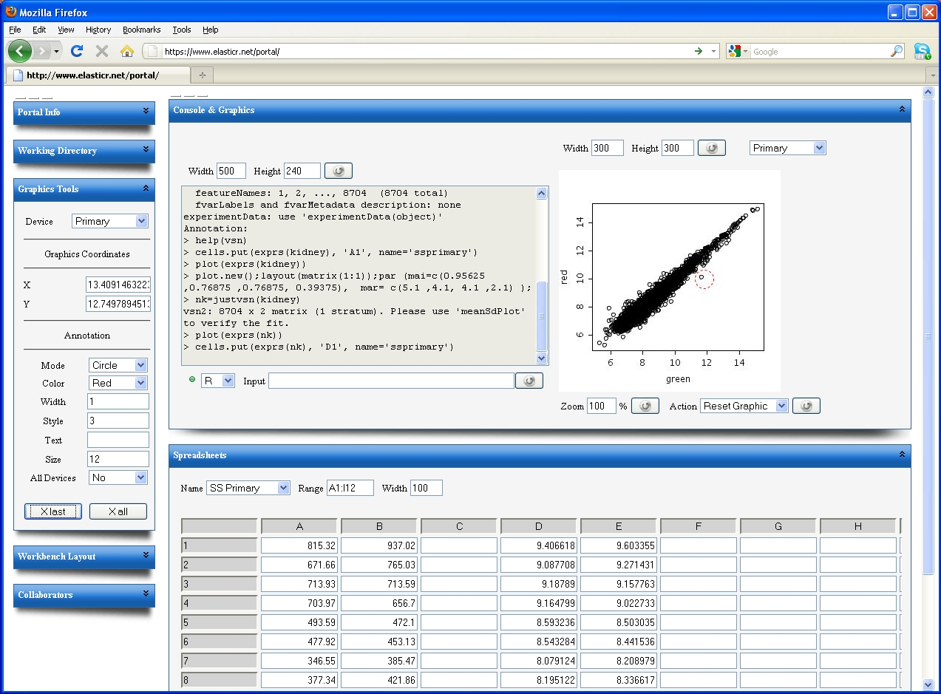
The Elastic-R AJAX Workbench III
Graphic device selector
Graphics real coordinates
Graphic tools
Persistent collaborative
annotators + virtual laser
pointer + whiteboard + ..
Spreadsheet selector
Server-side, R-enabled
collaborative spreadsheet

Slide 14
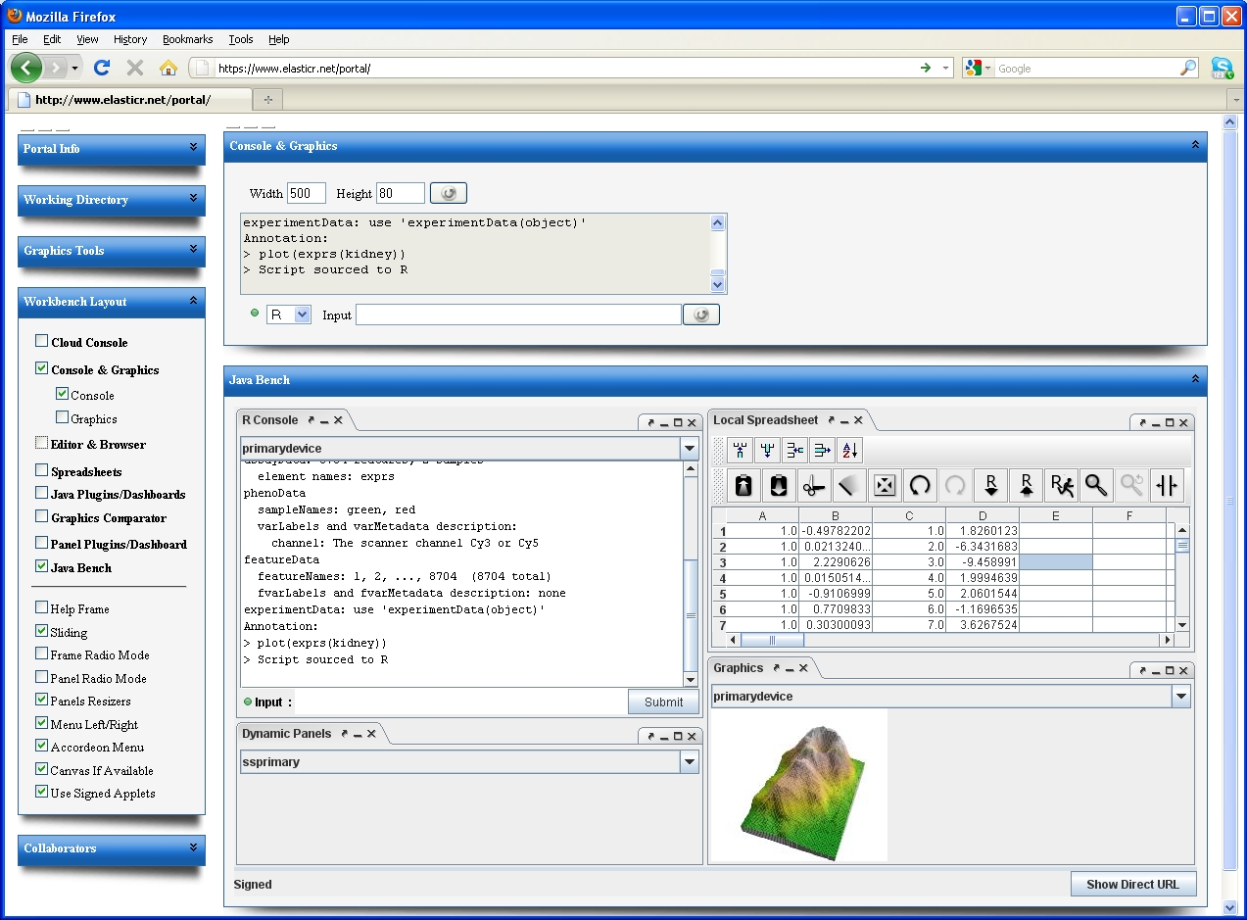
The Elastic-R Java Workbench

Slide 15
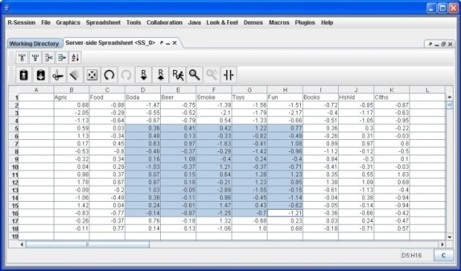
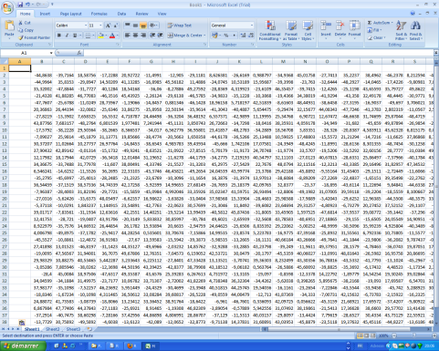
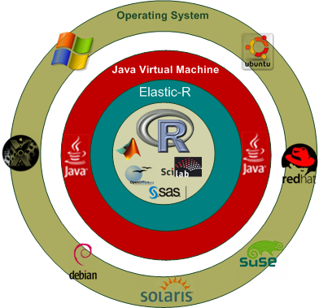
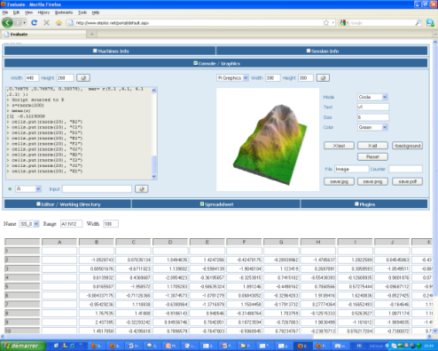
Software + services =applications convergence + collaboration
Elastic-R Java Workbench
Microsoft Excel
Elastic-R AJAX Workbench
Elastic-R AJAX Workbench
Elastic-R Spreadsheet model

Slide 16
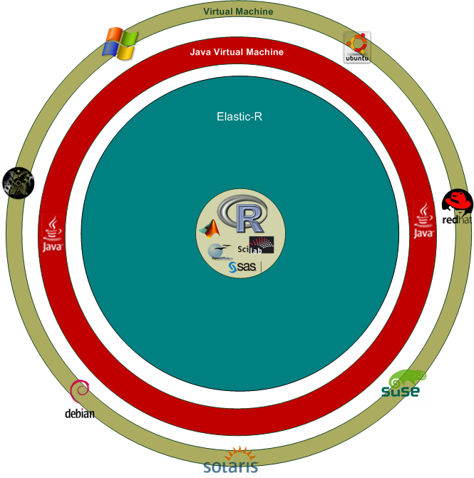
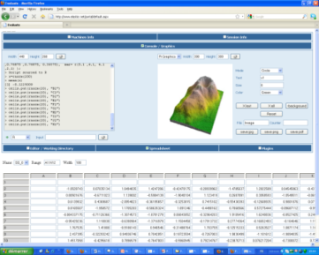
The Elastic-R server-side spreadsheet models / GUI widgets

Slide 17
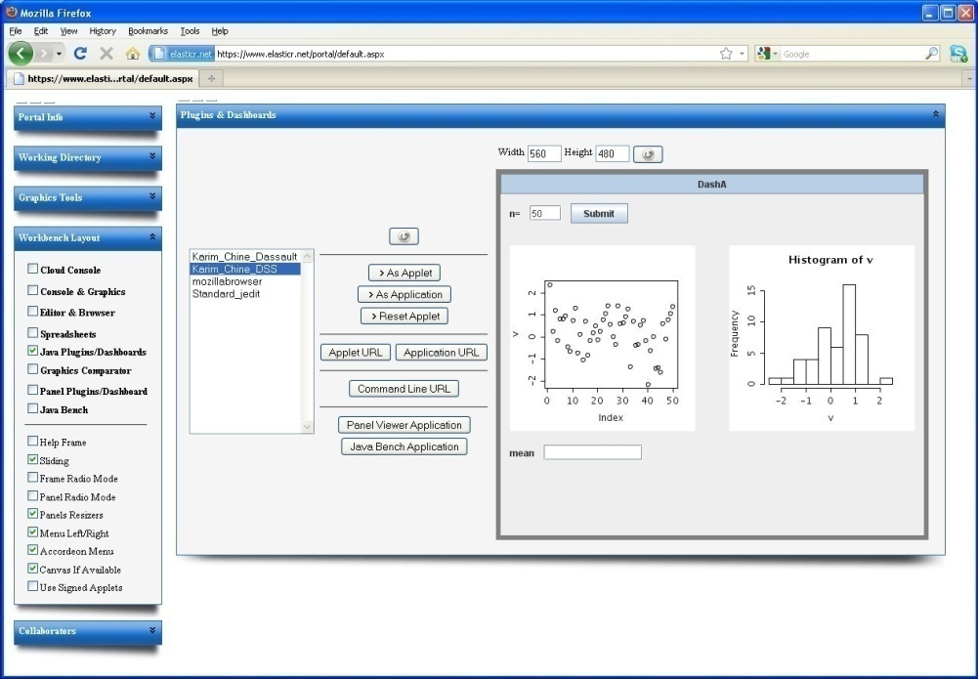
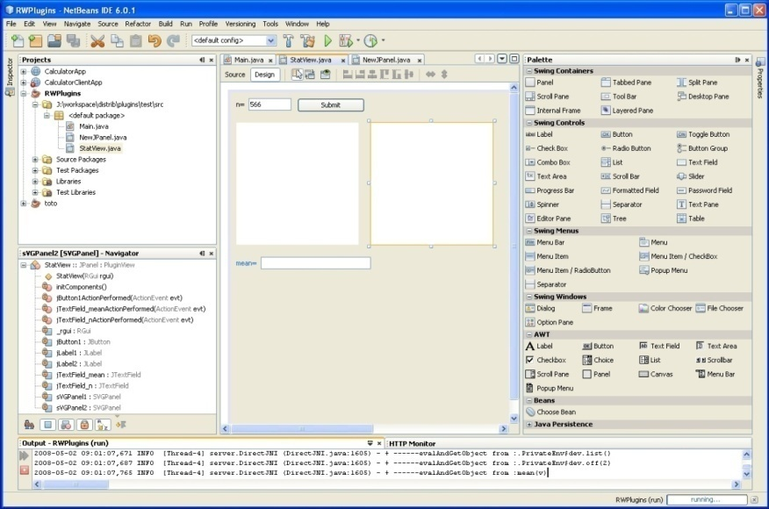
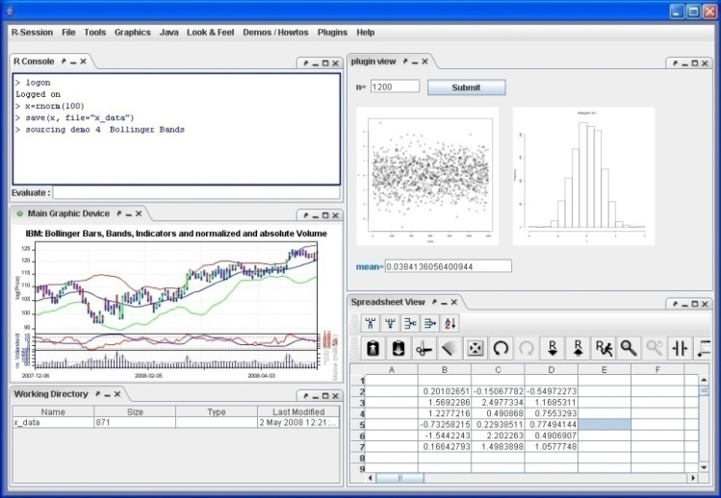
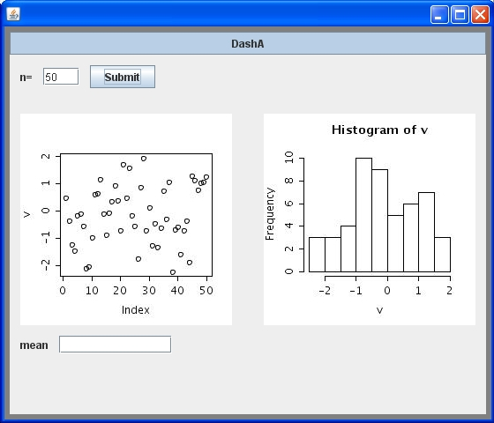
The cloud applications factory
Elastic-R AJAX Workbench
Visual Graphic User Interface Builder
Upload plugin
Standalone Application Accessible
From a URL
Elastic-R Java Workbench
Plugins Repository
myPlugin
myDashboard

Slide 18
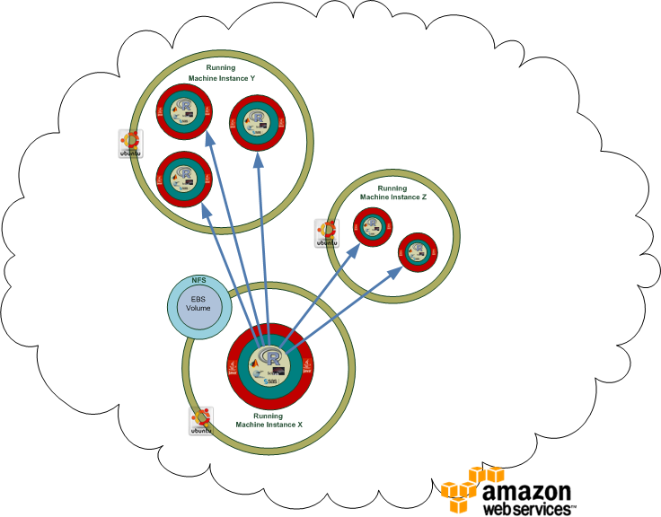
Elastic-R : user-friendly distributed computing platform

Slide 19
Demo

Slide 20
Useful links
Elastic-R Portal :
www.elasticr.net
Platform Web Site:
www.elasticr.net/platform
Articles :
Karim Chine, "Open Science in the Cloud: Towards a Universal Platform for Scientific and Statistical Computing", Chapter 19 in “Handbook of Cloud Computing”, Springer, 2010 (in press)
Karim Chine, "Scientific Computing Environments in the age of virtualization, toward a universal platform for the Cloud" pp. 44-48, 2009 IEEE International Workshop on Opensource Software for Scientific Computation (OSSC), 2009
Karim Chine, "Biocep, Towards a Federative, Collaborative, User-Centric, Grid-Enabled and Cloud-Ready Computational Open Platform,“ escience,pp.321-322, 2008 Fourth IEEE International Conference on eScience, 2008
Linkedin Group:
http://www.linkedin.com/groups?home=&gid=2345405

Slide 21
Acknowledgments
ACS: Madi Nassiri Amazon: Simone Brunozzi, Deepak Singh AT&T Research Labs: Simon Urbanek ATUGE: Imen Essafi, Béchir Tourki, Ilyes Gouja, HatemHachicha, Amine Elleuch Auckland Centre for eResearch: Nick Jones Banca d'Italia: Giuseppe Bruno Bio-IT World: Kevin Davies BNP Paribas: Ousseynou Nakoulima Cambridge Healthtech Institute: Cindy Crowninshield City University of New York: Mario Morales, Makram Talih Columbia University: Omar Besbes Dassault Systèmes: Omri Ben Ayoun, Patrick Johnson Dataspora: Michael E. Driscoll EDF: Alejandro Ribes EBI: Alvis Brazma, Wolfgang Huber, Kimmo Kallio, Misha Kapushesky, Michael Kleen, Alberto Labarga, Philippe Rocca-Serra, Ugis Sarkans, Kirsten Williams, Eamonn Maguire EPFL: Darlene Goldstein ESPRIT: Farouk Kammoun, Tahar. Benlakhdar e-Taalim: Nadhir Douma ETH Zürich: Yohan Chalabi, Diethelm Würtz, Martin Mächler European Commission: Konstantinos Glinos, Enric Mitjana, Monika Kacik, Ioannis Sagias FHCRC: Martin Morgan, Nianhua Li, Seth Falcon Google: Olivier Bosquet FVG LLC: Lisa Wood Harvard University: Tim Clark, Sudeshna Das, Douglas Burke,Paolo Ciccarese IBM: Jean-Louis Bernaudin, Pascal Sempe, Loic Simon, Lea A Deleris, Alex Fleischer, Alain Chabrier Imperial College London: Asif Akram, Vasa Curcin, John Darlington, Brian Fuchs Indiana University:Michael Grobe INRIA: David Monteau, Christian Saguez, Claude Gomez, Sylvestre Ledru JISC: John Wood, David Flanders Johnson & Johnson - Janssen Pharmaceutica: Patrick Marichal KXEN: Eric Marcade Lancaster University: Robert Crouchley, Daniel Grose Leibniz Universität Hannover: Kornelius Rohmeier LIAMA: Baogang Hue, Kang Cai Limagrain: Zivan Karaman Mekentosj: Alexander Griekspoor, Matt Wood Microsoft: Eric Le Marois, Tony Hey Mubadala: Ghazi Ben Amor Nature Publishing Group: Ian Mulvany, Steve Scott NCeSS: Peter Halfpenny, Rob Procter, Marzieh Asgari-Targhi, Alex Voss, YuWei Lin, Mercedes Argüello Casteleiro, Wei Jie, Meik Poschen, Katy Middlebrough, Pascal Ekin, June Finch, Farzana Latif, Elisa Pieri, Frank O'Donnell New York Java User Group: Frank D Greco OeRC: Dimitrina Spencer, Matteo Turilli, David Wallom, Steven Young OMII-UK: Neil Chue Hong, Steve Brewer OpenAnalytics: Tobias Verbeke Oracle: Dominique van Deth, Andrew Bond OSS Watch: Ross Gardler Platform Computing: Christopher Smith Royal Society: James Wilsdon San Diego Supercomputer Center: Nancy R. Wilkins-Diehr Sanger Institute: Lars Jorgensen, Phil Butcher Shell: Wayne.W.Jones, Nigel Smith Société Générale: Anis Maktouf Stanford University: John Chambers, Balasubramanian Narasimhan, Gunter Walther SYSTEM@TIC: Karim Azoum Technische Universität Dortmund: Uwe Ligges, Bernd Bischl Technoforge: Pierre-Antoine Durgeat Tekiano: Samy Ben Naceur Télécom-ParisTech: Isabelle Demeure, Georges Hebrail, Nesrine Gabsi The Generations Network: Jim Porzak Total: Yannick Perigois Tunisian Ministry of Communication Technologies: Naceur Ammar, Lamia Chaffai-Sghaier, Mohamed Saïd Ouerghi, Syrine Tlili Tunisian Ecole Polytechnique: Riadh Robbana UC Berkeley: Noureddine El Karoui, Terry Speed UC Davis: Rudy Beran, Debashis Paul, Duncan Temple Lang UCL: Daniel Jeffares UCLA: Ivo Dinov, Jeroen Ooms UC San Diego: Anthony Gamst UCSF: Tena Sakai Université Catholique de Louvain: Christian Ritter University of Cambridge: Ian Roberts, Robert MacInnis Peter Murray-Rust, Jim Downing University of Manchester: Carole Goble, Len Gill, Simon Peters, Richard D Pearson, Iain Buchan, John Ainsworth University of Plymouth: Paul Hewson University of Split: Ivica Puljak UTK: Ajay Ohri World Bank Group-IFC: Oualid Ammar Yahoo: Laurent Mirguet, Rob Weltman Independant:Charles Dallas, Romain François

Slide 22
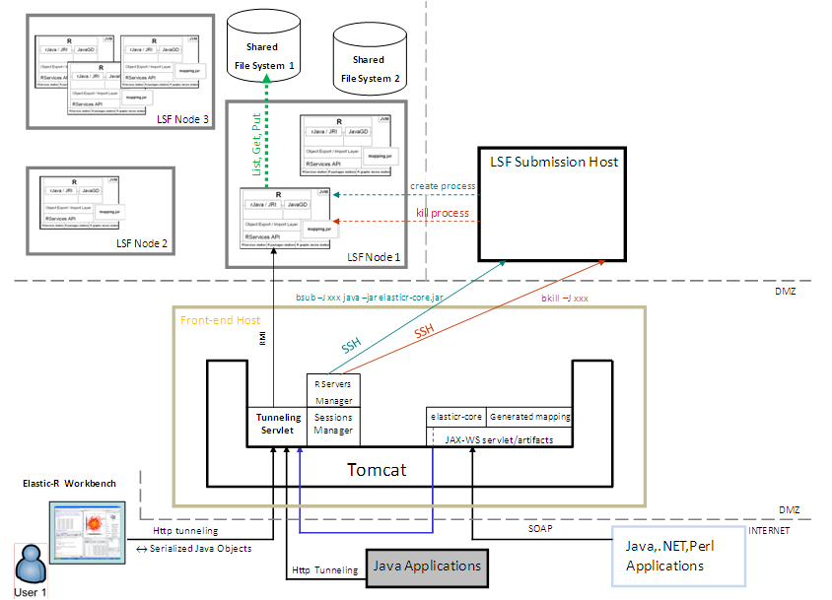
Elastic-R for clusters/grids

Slide 23
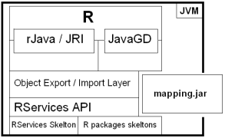
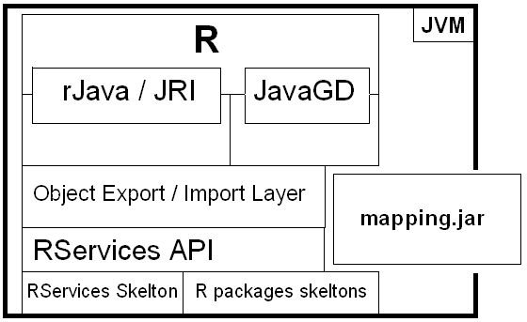
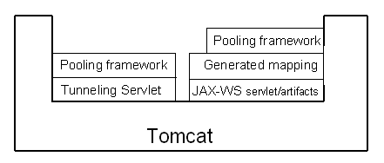
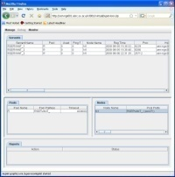
Elastic-R SOA platform
Pool A
Pool B
Pool C
Node 1: Windows XP
Node 2: Mac OS
Front-end host
Remote Objects
Registry
R-HTTP
R-SOAP
Node 3: 64 bits Server / Linux
Parallel Computing Applications
→ Borrow Rs
→ Use Rs
→ Release Rs
Supervisor
.NET Appli
→ logOn
→ Use R
→ logOff
Perl Scripts
→ logOn
→ Use R
→ logOff
Node 4 : EC2 virtual machine 1
Node 4 : EC2 virtual machine 1
Web Application
→ Borrow R
→ Generate Graphics/Data
→ Release R
Cloudbursting
via Amazon Web Services
Node 5 : EC2 virtual machine 2

Slide 24
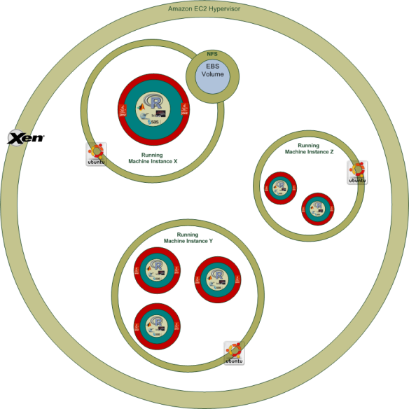
Stateful generated Web Services : Elastic-R for workflow workbenches
Login
LogOn
SessionID associated with a reserved Elastic-R Engine
Pwd
Options
T1
ES
T2
ESon2
T3
ESon3
getData
f ( ES )
ESon1
Retrieve Data
T1,T2,T3 : Generated Stateful Web Services for R functions T1,T2 & T3
LogOn, getData : R-SOAP methods
ES : ExpressionSet
ESon1, ESon2, ESon3 : ExpressionSet Object Names
f = T3 o T2 o T1
logOff
• remove ESonx
• « Clean » Elastic-R Engine
• Put Elastic-R Engine back in the Pool
• kill Elastic-R Engine

